Slide 1

an iot approach for detection of movement
Under Guidance Of:
Dr Venkatesulu Dondeti Prof. & HoD, CSE Dept.
Project member’s
M Naveen(141fa04189)
P Mahesh(141fa04039)
Notes:
NOTE:
To change the image on this slide, select the picture and delete it. Then click the Pictures icon in the placeholder to insert your own image.

Slide 2
Requirments gathering
This project aims to describe a security alarm system using low processing power chips using Internet of things which helps to monitor and get alarms(email) when movement is detected .The email will be sent with attachement of photo

Slide 3
Software specification

Slide 4
Proposed system
Email based human motion detection is an embedded system which we are used to provide security.
Instead of manual security if we use alarm based detection system for detecting human motions to provide security which reduces man power and is very cheap.
When a person moving around this circuit, PIR sensor detects the change in the IR levels of surroundings and sends a signal to the microcontroller.
Features of proposed system are:
It is very cheap and affordable.
It is efficient and portable that means we can place this circuit at any place easily.
Very easy to use.
Maintenance cost is low.

Slide 5
Functional requirments
Hardware components
Raspberry pi
Camera
pirsensor
Software components
Rasperrian os
Python
Html,css
Mysqldb
Xampp

Slide 6

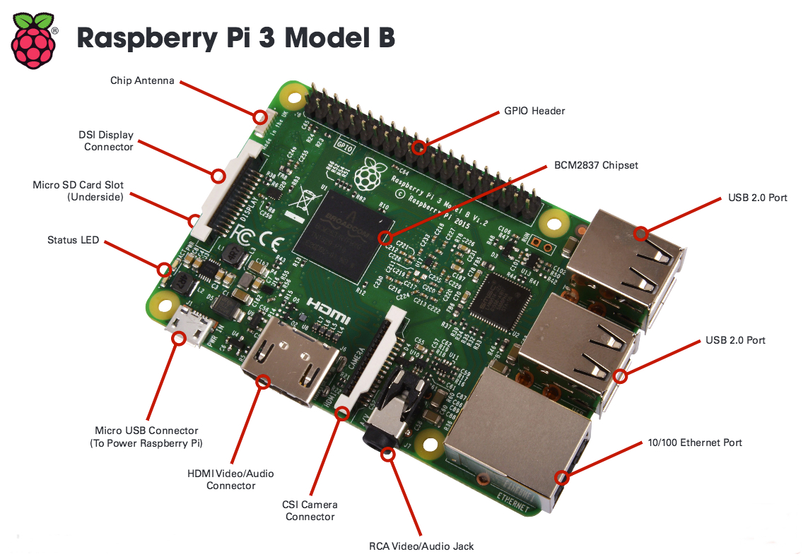
RASBERRY PI
The Raspberry Pi 3 Model B is the third generation Raspberry Pi
Additionally it adds wireless LAN & Bluetooth connectivity making it the ideal solution for powerful connected

Slide 7
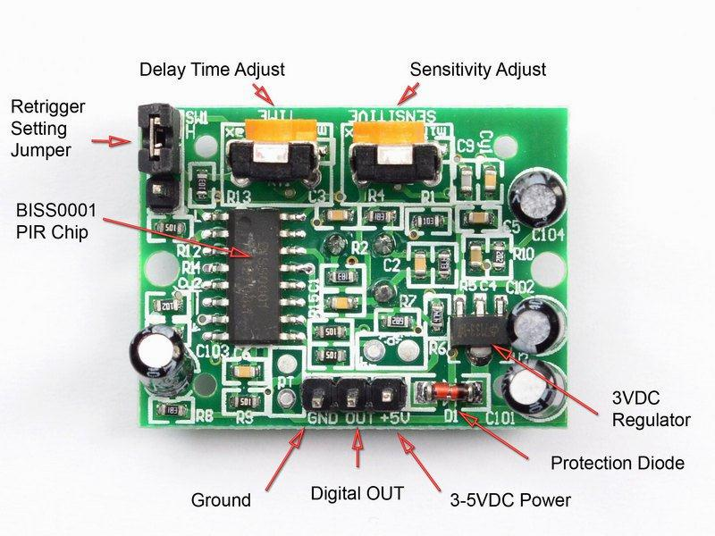
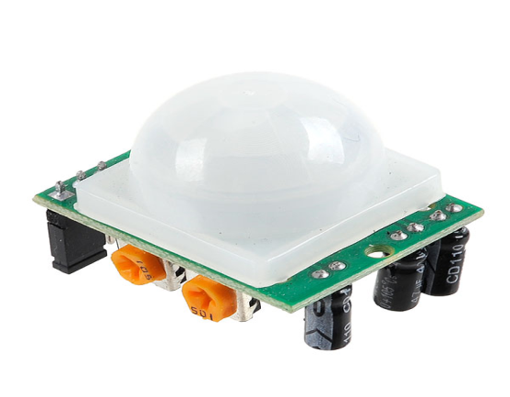
PIR SENSOR
PIR sensors allow you to sense motion, almost always used to detect whether a human has moved in or out of the sensors range.
They are often referred to as PIR, "Passive Infrared", "Pyroelectric", or "IR motion" sensors.
Specifications
Size: Rectangular
Output: Digital pulse high (3V) when triggered (motion detected)
Sensitivity range: up to 20 feet (6 meters) 110° x 70° detection range
Power supply: 5V-12V input voltage

Slide 8
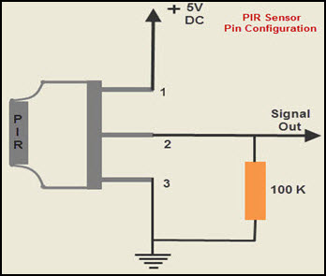
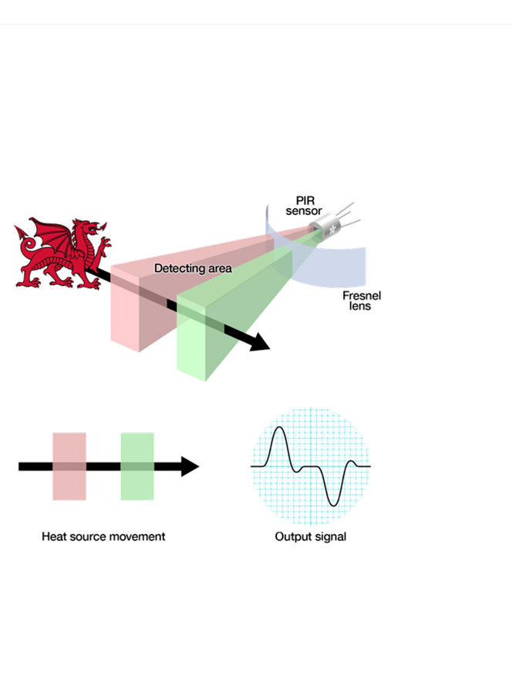
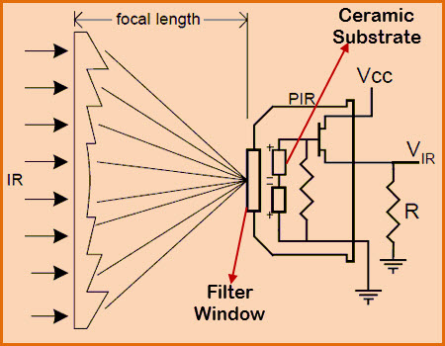
Working of pir

Slide 9
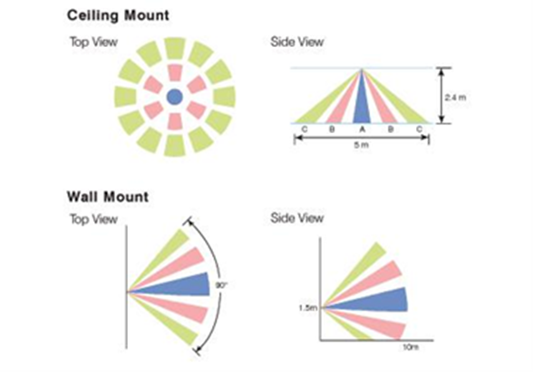

Slide 10
SYSTEM DESIGN

Slide 11
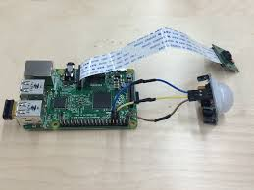
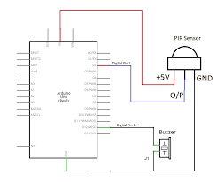
Circuit connection
Pir Ground – gpio pin6
Pir vcc(power)- gpio pin4
Pir output – Gpio pin 16

Slide 12
Python Code

Slide 13
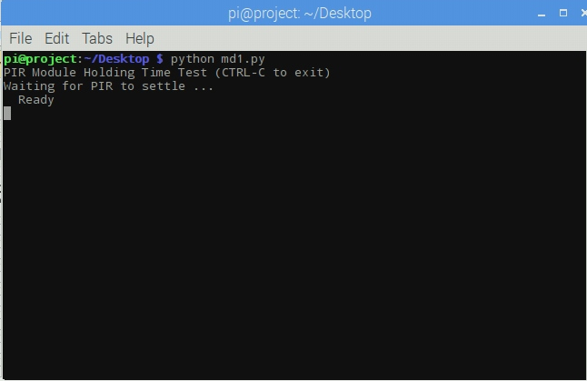
output

Slide 14
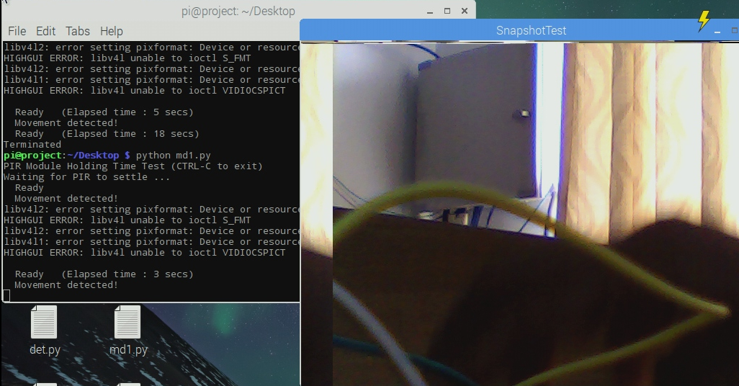

Slide 15

frontend

Slide 16
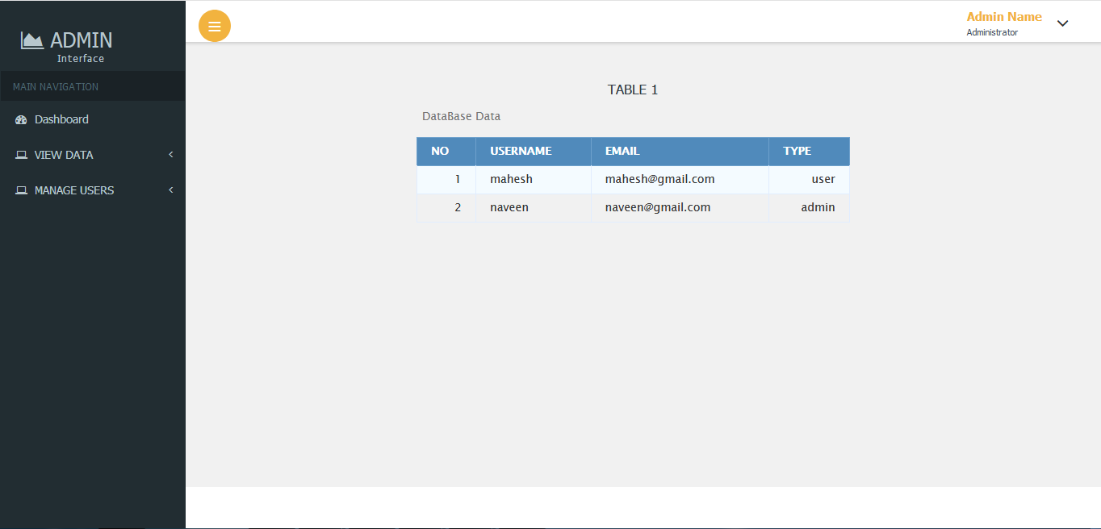
Admin interface

Slide 17
THANK YOU

